Slide 1





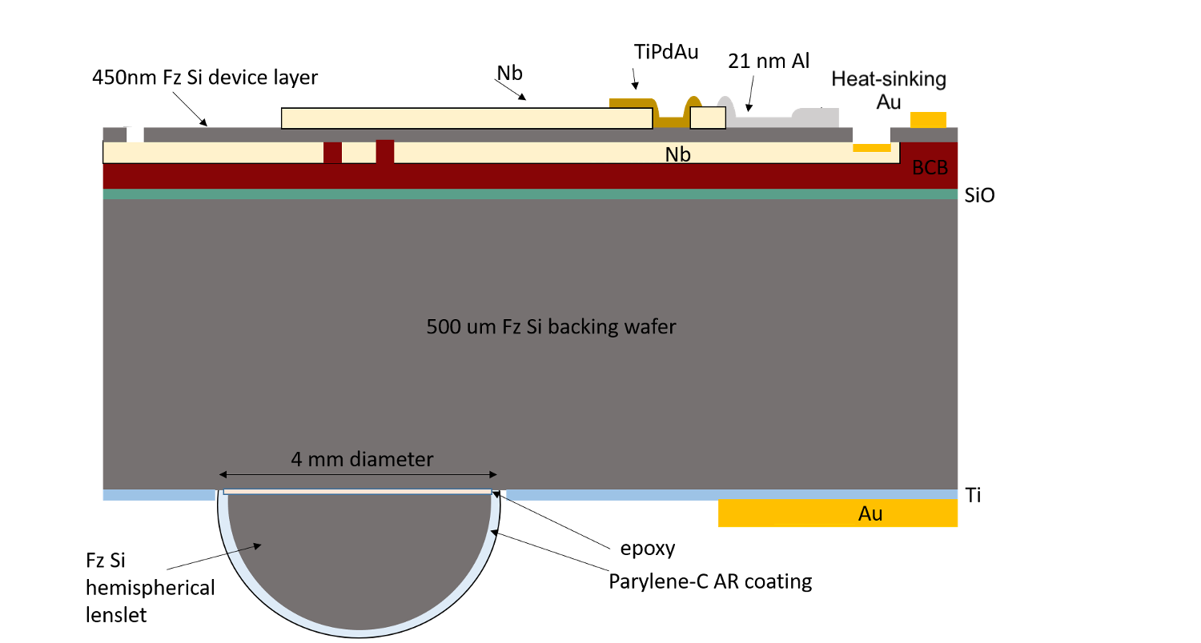
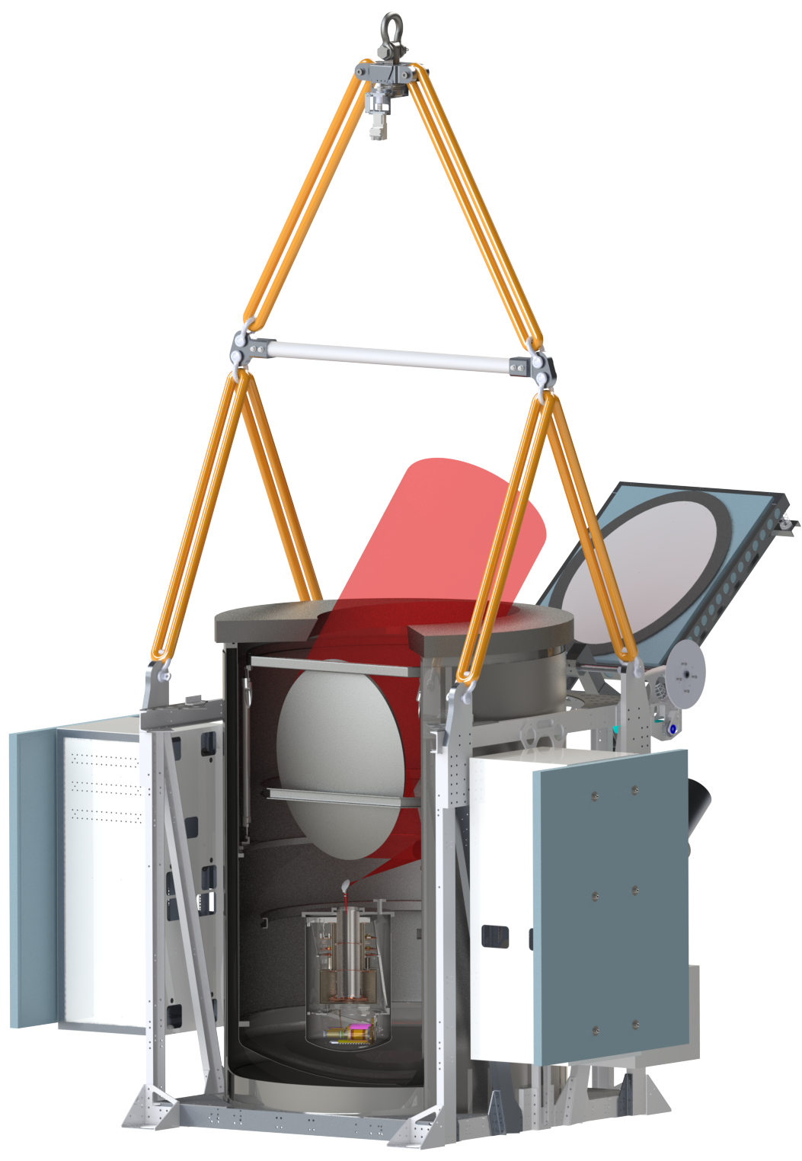
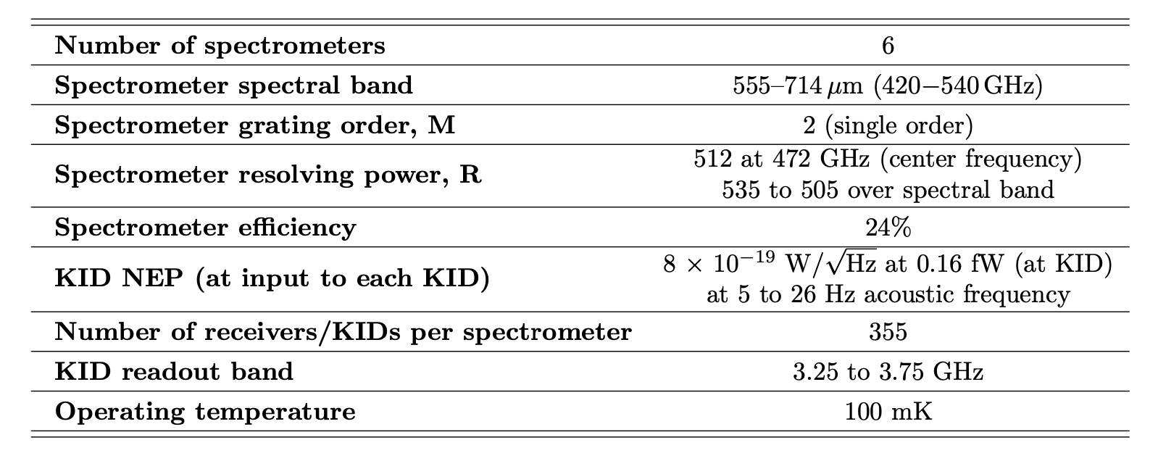
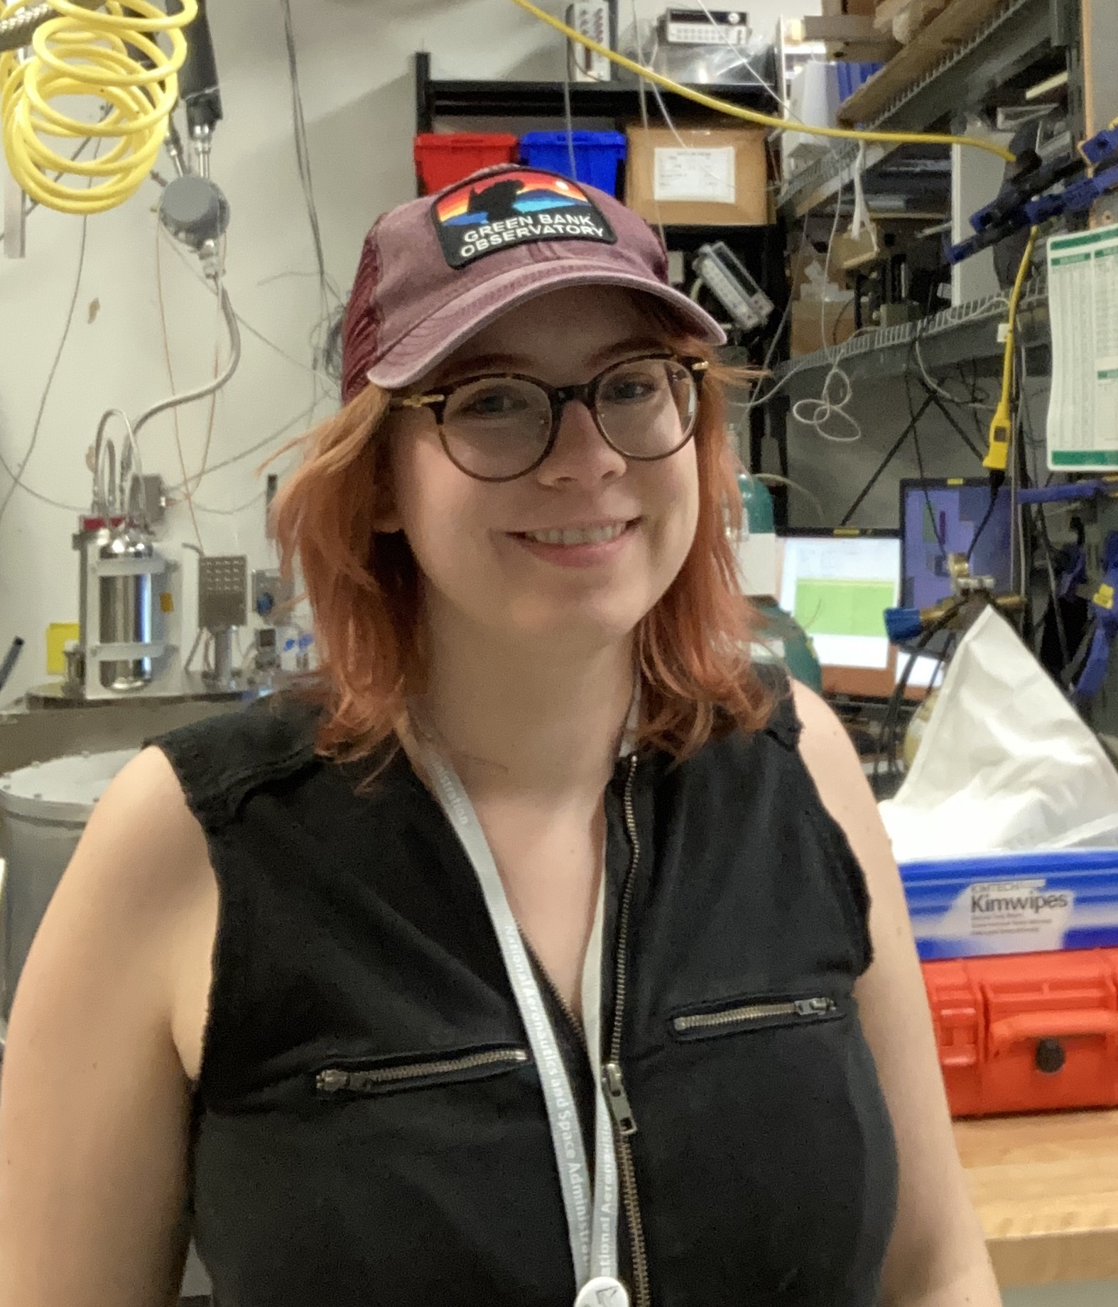

Developing a New Generation of Integrated μ-Spec
Far-Infrared Spectrometers for EXCLAIM
Carolyn Volpert¹, Emily Barrentine², Mona Mirzaei², Alyssa Barlis², Alberto Bolatto¹, Berhanu Bulcha,² Giuseppe Cataldo², Jake Connors³, Nicholas Costen², Negar Ehsan², Thomas Essinger-Hileman², Jason Glenn², James Hays-Wehle², Jonas Mugge-Durum⁴, Larry Hess², Alan Kogut², Harvey Moseley⁵, Omid Noroozian², Trevor Oxholm⁶, Maryam Rahmani²,Thomas Stevenson², Eric R. Switzer², Joseph Watson², and Edward Wollack²
¹University of Maryland, College Park, MD, USA; ²NASA Goddard Spaceflight Center, Greenbelt, MD, USA; ³National Institute of Standards and Technology, Boulder, CO, USA; ⁴Deutsches Zentrum fur Luft und Raumfahr, Koln, DE; ⁵Quantum Circuit, Inc., USA; ⁶University of Wisconsin-Madison, Madison, WI, USA
1
ABSTRACT
3
FABRICATION
EXCLAIM MISSION
The EXperiment for Cryogenic Large-Aperture Intensity Mapping (EXCLAIM) is a balloon borne far-infrared astronomy mission that uses line intensity mapping to target extragalactic measurements of the CO rotational emission ladder at redshifts z < 1 and CII emission at redshifts z = 2.5−3.5. EXCLAIM will additionally map [CI] in the Milky Way to probe the commonly assumed CO/H₂ ratio.
The current state of far-infrared astronomy drives the need to develop compact, sensitive spectrometers for future space and ground-based instruments. Here we present details of the μ-Spec spectrometers currently in development for the far-infrared balloon mission EXCLAIM. The spectrometers are designed to cover the 555 – 714 μm range with a resolution of R = λ/∆λ = 512 at the 638 μm band center. The spectrometer design incorporates a Rowland grating spectrometer implemented in a parallel plate waveguide on a low-loss single-crystal Si chip, employing Nb microstrip planar transmission lines and thin-film Al kinetic inductance detectors (KIDs). The EXCLAIM μ-Spec design is an advancement upon a successful R = 64 μ-Spec prototype, and can be considered a sub-mm superconducting photonic integrated circuit (PIC) that combines spectral dispersion and detection. The design operates in a single M = 2 grating order, allowing one spectrometer to cover the full EXCLAIM band without requiring a multi-order focal plane. The EXCLAIM instrument will fly six spectrometers, which are fabricated on a single 150 mm diameter Si wafer. Fabrication involves a flip- wafer-bonding process with patterning of the superconducting layers on both sides of the Si dielectric. The spectrometers are designed to operate at 100 mK, and will include 355 Al KID detectors targeting a goal of NEP ∼ 8×10⁻¹⁹ W/√Hz. We summarize the design, fabrication, and ongoing development of these μ-Spec spectrometers for EXCLAIM.
Survey size: ~300 deg² area (wide)
Scan: ~7° in azimuth at fixed elevation 45°
Beam size: 76 cm projected aperture =~4’ FWHM.
Redshifts: CO 0 < z < 0.6+, CII 2.5 < z < 3.5, CI z ~ 0
Cross correlation: BOSS quasars
Spectrometer: MKID on-chip u-Spec
Detectors: Antenna-coupled MKID
Flight duration: conventional (e.g. 1-day) flight
Flight location: NM, USA
Cryogenics: 3500 l LHe Bucket dewar
Balloon class: ~2400 kg dry mass, 34 MCF
Holding time: ~2000 l LHe fill gives 18 hr of
1.7K operation at float
Cold optics: superfluid fountain-effect pumps
cool the optics to 1.7 K (Kogut+ 2021)
Heritage: ARCADE/PIPER
^{(ref 4,6)}
The EXCLAIM μ-Spec fabrication heavily leverages the processes developed for the R = 64 prototypes with new steps based on prototype and test device results. The spectrometer contains superconducting Al and Nb films that are fabricated on the two faces of a single-crystal float zone (f-z) silicon device layer of 450-nm thickness.
The fabrication process begins with patterning the Nb ground plane layer on an SOI wafer. Taking many steps to protect the wafer, the Nb is sputter deposited and lift off is safely achieved. The Nb ground plane side of the SOI wafer is then bonded to the front side of the f-z Si wafer. The handle layer of SOI wafer is removed, and the buried oxide layer is etched to expose the other side of the Si device layer. The top-side Nb is patterned with the similar lift-off process, but with lithography performed in two steps. An AuPd layer with a Ti adhesion layer is then patterned via a lift-off process between and over areas of the Nb microstrip lines, and a Au layer for heatsinking is also deposited and patterned via a lift-off process. Then the Al film is sputter-depositing and patterned via wet-etching to form the MKID array structure. Then, while the wafer frontside is protected with a protective resist, the Au and Ti layers are patterned on the back side of the supporting Si backing wafer.
^{(ref 1)}
2
SPECTROMETER OVERVIEW
After light travels through the telescope’s cold optics, it is focused onto a focal plane that contains six 4 mm-diameter hyper-hemispherical silicon lenslets, each attached to the back of a spectrometer chip. → The light incident on the lenslet is then coupled into each spectrometer layer on the opposite side of the wafer through an x-slot antenna, where an impedance transformer then modifies the signal to match the impedance of the spectrometer’s Nb microstrip transmission lines, which are of microstrip design. → The light then travels through an order selecting filter that selects the M=2 order, and travels into a network of Nb transmission lines of varying meandered lengths that impose an approximately linear phase gradient across the array with corrections for dispersion. → The light then is sent to an array of Nb microstrip feed structure emitters, and emitted into a 2D interference region consisting of parallel-plate waveguide formed by the top and ground plane Nb superconducting layers and the single-crystal Si dielectric. → Across the 2D region, the light interferes constructively and destructively with itself as a product of the phase delay, analogous to the operation of a classic free-space spectrometer grating. → The light is then coupled into an array of microstrip feed receiver structures on the far side of the interference region, and travels through transmission lines to a corresponding array of KIDs.
5
PACKAGE
Above: Some key information about EXCLAIM’s spectrometers.¹
Right: The main contributing components to the overall efficiency of the EXCLAIM spectro-meters and their individual efficiencies estimated from design.²
The slot antenna coupling and the Rowland receiver array coupling (part e. in center spectrometer figure) have the largest impact on the spectrometers’ efficiency. The fact that EXCLAIM uses a focal-plane design is in-part responsible for the antenna coupling efficiency.
^{(ref 1, 3)}
4
STRAY LIGHT
Principles of Package Design:
All six on-chip μ-Spectrometers fit without touching in one superstructure.
The lenslets of the individual spectrometers are aligned in the focal plane when cold.
The spring and clip design secure the spectrometers and allow for thermal contraction when cold.
Individual spectrometers can be easily interchanged if certain if certain design elements are retained, minimizing re-packaging steps and allowing future devices to also use the same package.
Heat sinking occurs through a copper bus to an ADR, and is maintained at 100 mK.
Blackening epoxy is applied where possible to mitigate stray light and reflections.
Each spectrometer has two SMA connections for readout.
Based on results from the R=64 μ-Spec prototype, special design attention has been placed on mitigating the effects of stray light in the EXCLAIM spectrometers.
Changes include:
The addition of a thin Ti coating layer with a thickness designed to target a sheet resistance optimized to terminate stray light in the Si backing wafer.
The addition of a layer of normal-metal Au solely under the portion of the spectrometer housing the KIDs, to act as a trap for cosmic-ray excited phonons.
An RF design that minimizes ground plane cuts.
Al feedlines for readout that absorb thermal radiation > 90 GHz.
And others in the table below:
Figure: A schematic of an EXCLAIM spectrometer with detailed cutouts of individual components²:
The spectrometer’s x-slot antenna depicted with the impedance transformer and a secondary transformer shown towards the bottom of the image. On the bottom left is a cutout showing a closeup of the antenna feed.
An order sorting filter between the antenna and the phase-delay network that exclusively selects the order M=2. On the right the main feedline is coupled to a reference KIDs, which measures total power.
The spectrometer’s phase-delay network. A cutout shows a closeup example of some of the meandered Nb transmission lines, which vary in path length.
A close-up of the sidewall of the 2D interference region, designed to terminate the portion of light that is reflected by the receiver array and input radiation that is outside of the EXCLAIM band.
STATUS
The EXCLAIM six-spectrometer superstructure package design is complete.
The design phase for EXCLAIM’s spectrometers is complete, and the first spectrometers are expected to be yielded in early fall of 2022 to begin to undergo characterization testing.
EXCLAIM plans to take its first <24 hr flight from NASA’s Ft. Sumner, New Mexico facility in Fall 2023.
A closeup of the top portion of the receiver array. The receiver horns feed into Nb transmission lines that connect to the spectrometer detector array.
REFERENCES:
The Nb lines from the receiver array connect to an array of thin-film Al microstrip KIDs. Detectors designed to diagnose noise and stray light, such as those uncoupled from the rest of the spectrometer (’dark’ detectors) and those whose path skips the interference region, are included at the edges of the KID array.
The KIDs in the array are all coupled via parallel-plate capacitors to the readout transmission line.
¹Switzer, E. R., Barrentine, et al., “Experiment for cryogenic large-aperture intensity mapping: instrument design,” JATIS, 7(4), 044004 (2021). ²Cataldo, G., Barrentine, E. M., et al., “Second-generation micro-spec: A compact spectrometer for far-infrared and submillimeter space missions,” Acta Astronautica 162, 155–159 (2019). ³Essinger-Hileman, T., Oxholm, T., et al., “Optical design of the EXperiment for Cryogenic Large-Aperture Intensity Mapping (EXCLAIM),” in [Millimeter, Submillimeter, and Far-Infrared Detectors and Instrumentation for Astronomy X ], 11453, 85 – 99, SPIE (2020). ⁴Patel, A., Brown, A.-D., Hsieh, et al., “Fabrication of MKIDS for the MicroSpec spectrometer,” IEEE Trans. Appl. Supercond. 23(3), 2400404–2400404 (2013). ⁵Brown, A. D. and Patel, A. A., “High precision metal thin film liftoff technique,” (July 7 2015). US Patent 9,076,658. ⁶Mirzaei, M., Barrentine, E. M., et al., “μ-spec spectrometers for the EXCLAIM instrument,” in [Millimeter,
Submillimeter, and Far-Infrared Detectors and Instrumentation for Astronomy X ], 11453, 128 – 139, SPIE (2020).
Carrie Volpert
PhD Candidate
University of Maryland
This material is based upon work supported by NASA under award number 80GSFC21M0002.

